Slide 1
Explaining and Predicting Development Outcomes: From M&E Ratings to Evaluation Narratives
Diego Parra Alvarez Panel Interview (Analyst Position) Independent Evaluation Group (IEGHC)
World Bank

Slide 2

Overview
This presentation explores the relationship between Monitoring & Evaluation (M&E) Quality and Outcome Ratings in World Bank projects within the Human Development Practice Group, using a dataset of 328 projects approved between 2015 and 2025. To answer these, we apply a combination of methods:
Descriptive analysis across regions and M&E levels.
Causal inference using OLS, Ordered Logit, and Propensity Score Matching.
Machine learning models using both structured variables and unstructured text (sentiment analysis and n-gram features).
All code, data processing, and figures have been organized in a public GitHub repository to ensure transparency and reproducibility: https://github.com/diegopaal/IEG-Interview
GitHub repository for reproducibility

Slide 3
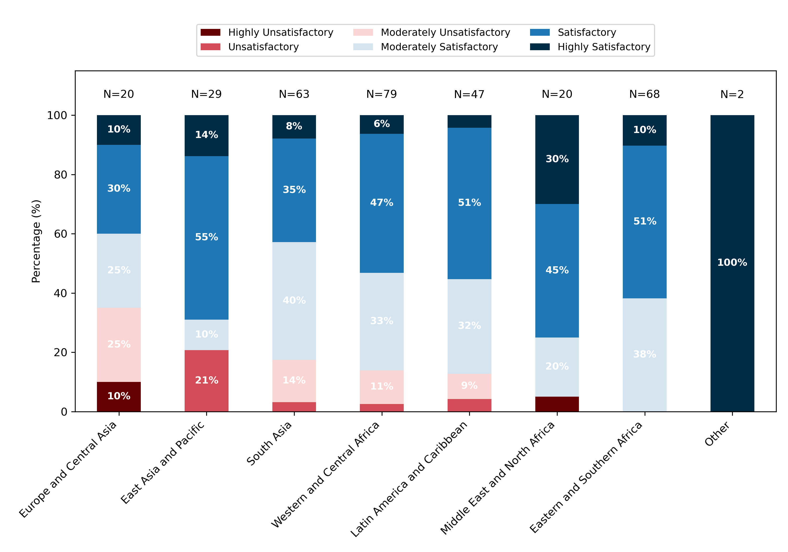
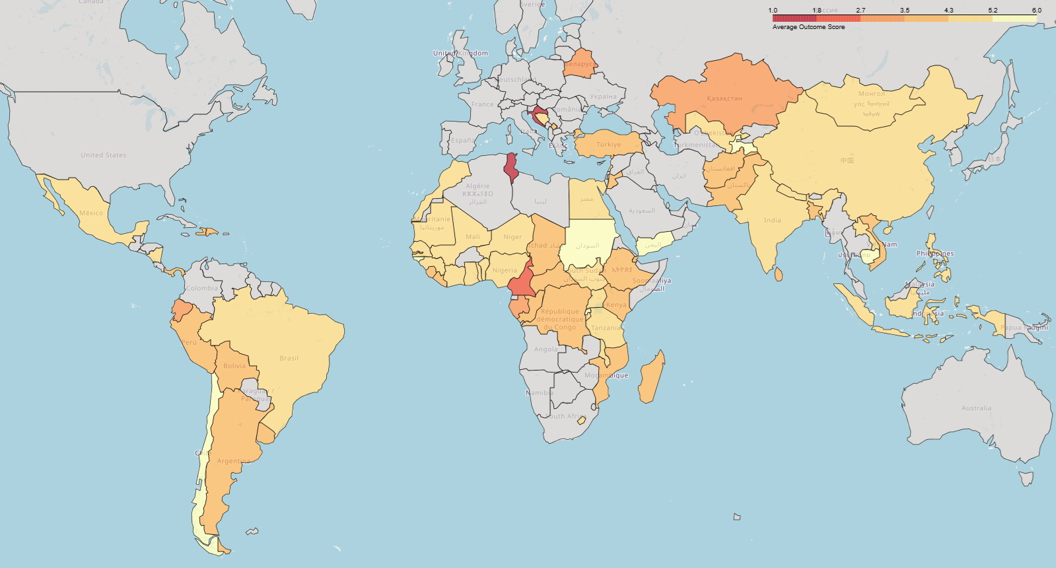
How do Outcome Ratings vary by region?
Easter and Southern Africa and MENA show higher shares of satisfactory results, while Europe & Central Asia and East Asia & Pacific have a greater proportion of unsatisfactory outcomes.
Figure 1. Distribution of Outcome Ratings by Region (%)
Map 1. Average Outcome Rating by Country (1 = Worst, 6 = Best).
Note: The interactive version of this map, displaying average scores and sample sizes, is available for download here.

Slide 4
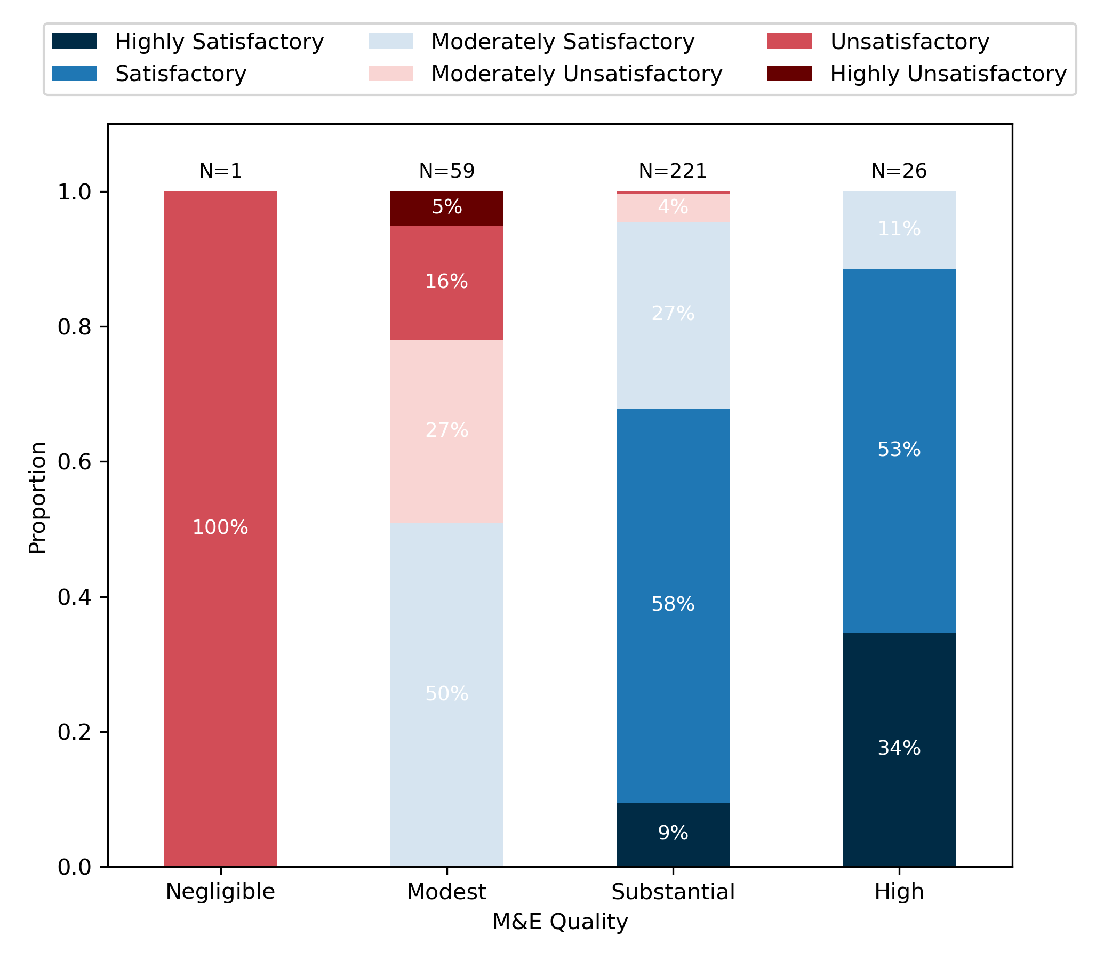
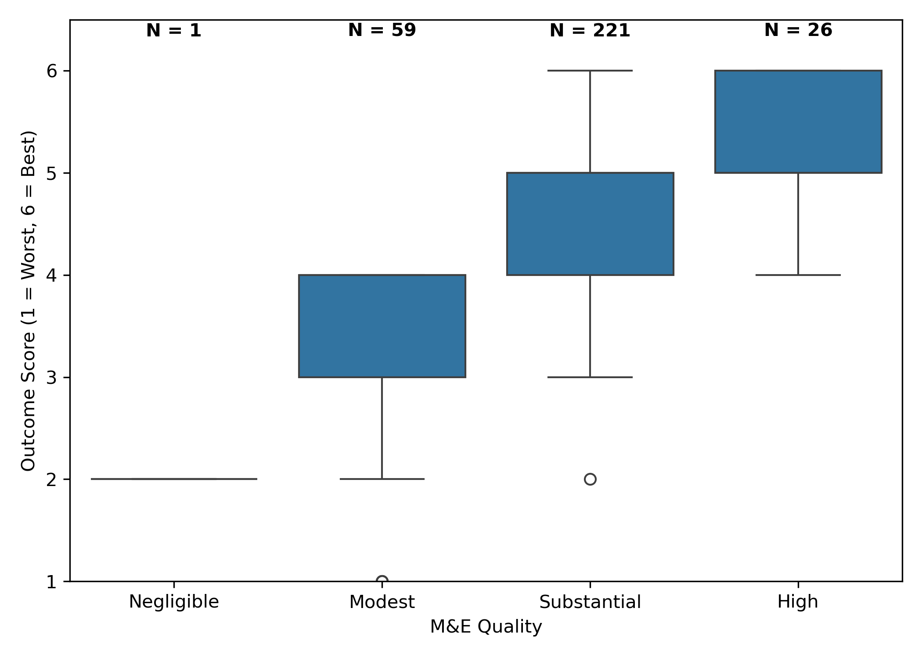
What is the relationship between Monitoring and Evaluation (M&E) Quality and Outcome Ratings?
Higher M&E quality is strongly associated with better and more consistent project outcomes. Figure 2 highlights a shift toward satisfactory outcomes, while Figure 3 shows increasing median scores as M&E quality improves.
Figure 2. Outcome Rating Distribution Across M&E Quality Levels
Figure 3. Mean Outcome Rating (Scale: 1 = Worst, 6 = Best): Median and Variability by M&E Quality

Slide 5
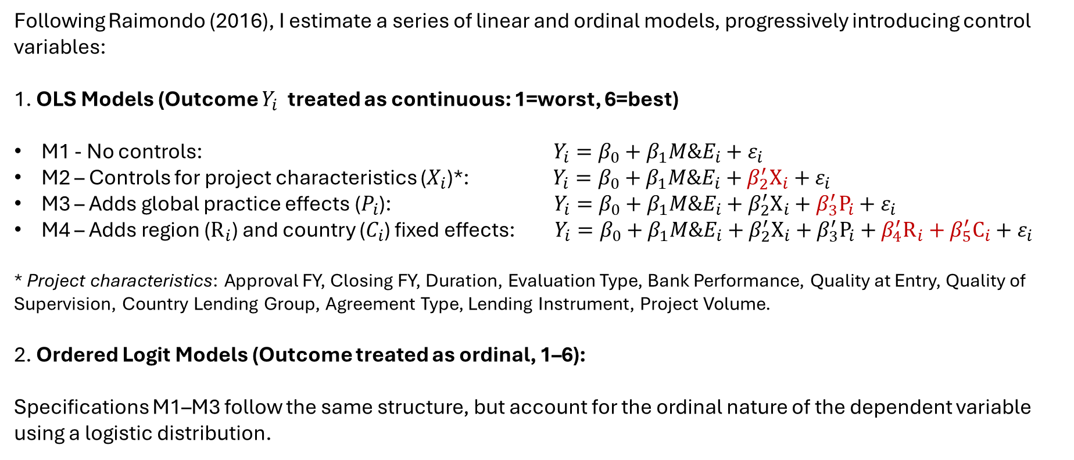
What is the relationship between Monitoring and Evaluation (M&E) Quality and Outcome Ratings?
Following Raimondo (2016), I estimate a series of linear and ordinal models, progressively introducing control variables:
1. OLS Models (Outcome $Y_{i}$ treated as continuous: 1=worst, 6=best)
M1 - No controls: $Y_{i}=β_{0}+β_{1}{M\&E}_{i}+ε_{i}$
M2 – Controls for project characteristics ($X_{i}$)*: $Y_{i}=β_{0}+β_{1}{M\&E}_{i}+β_{2}^{′}X_{i}+ε_{i}$
M3 – Adds global practice effects ($P_{i}$): $Y_{i}=β_{0}+β_{1}{M\&E}_{i}+β_{2}^{′}X_{i}+β_{3}^{′}P_{i}+ε_{i}$
M4 – Adds region ($R_{i}$) and country ($C_{i}$) fixed effects: $Y_{i}=β_{0}+β_{1}{M\&E}_{i}+β_{2}^{′}X_{i}+β_{3}^{′}P_{i}+β_{4}^{′}R_{i}+β_{5}^{′}C_{i}+ε_{i}$
* Project characteristics: Approval FY, Closing FY, Duration, Evaluation Type, Bank Performance, Quality at Entry, Quality of Supervision, Country Lending Group, Agreement Type, Lending Instrument, Project Volume.
2. Ordered Logit Models (Outcome treated as ordinal, 1–6):
Specifications M1–M3 follow the same structure, but account for the ordinal nature of the dependent variable using a logistic distribution.

Slide 6
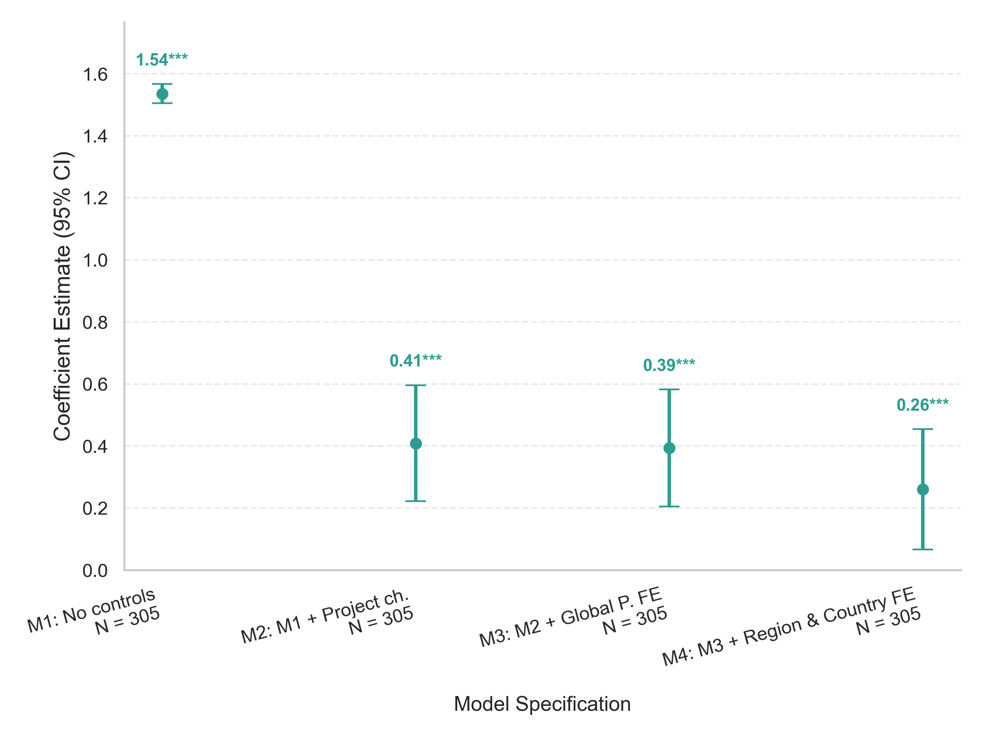
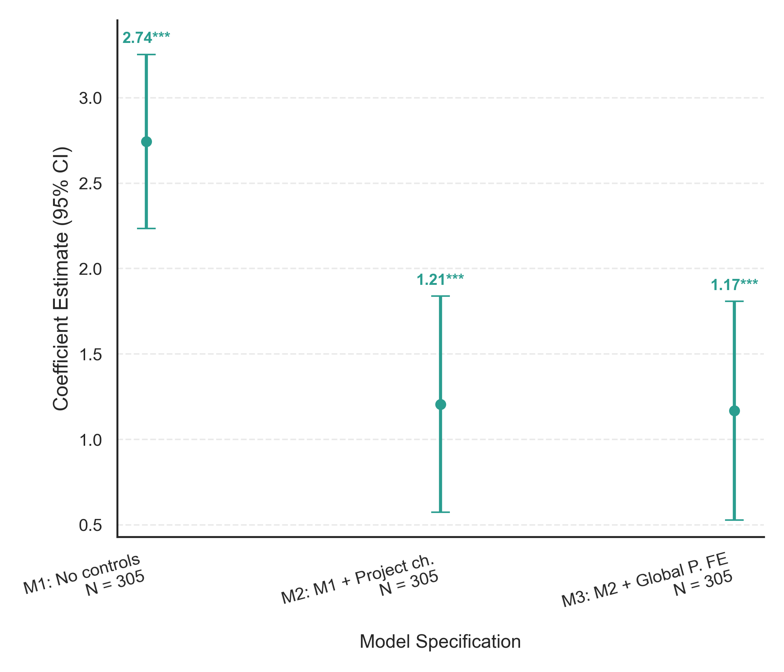
Estimation: M&E Quality vs. Outcome Ratings
Across all models, M&E Quality is positively and significantly associated with better Outcome Ratings, and the relationship remains robust after controlling for relevant covariates and fixed effects.
Figure 4. OLS estimation of the effect of M&E Quality on Outcome Ratings.
Figure 5. Ordered Logit estimation of the effect of M&E Quality on Outcome Ratings.

Slide 7
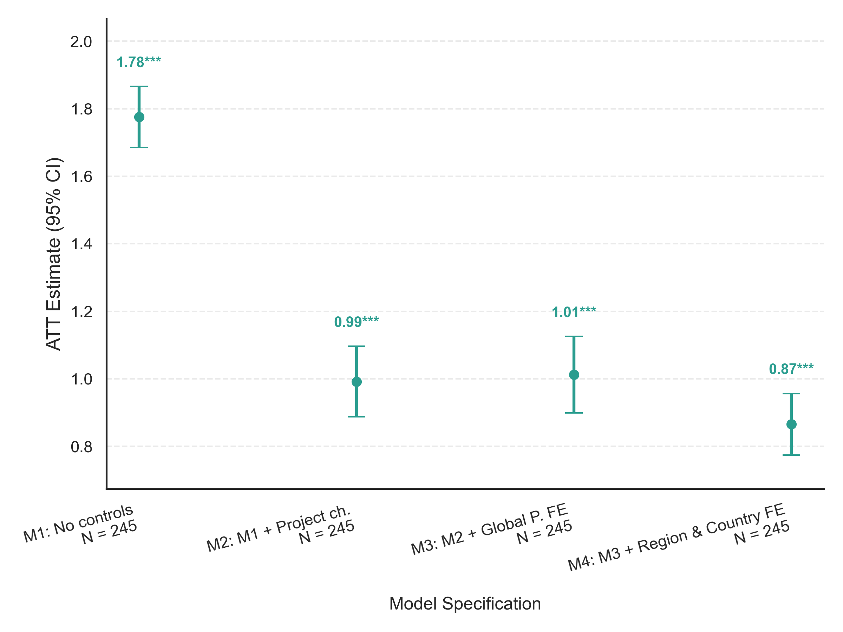
Estimation: M&E Quality vs. Outcome Ratings
Now we treat the question as a causal inference problem, where projects with high M&E Quality (M&E Score ≥ 3) are considered the treated group.
Figure 6. Average Treatment Effect on the Treated (ATT) estimation of the impact of M&E Quality on Outcome Ratings
Since M&E scores are not randomly assigned, we use Propensity Score Matching to account for selection bias.
Using nearest-neighbor matching, we estimate the Average Treatment effect on the Treated (ATT) (i.e. the expected difference in Outcome Ratings between treated projects and similar control projects with low M&E Quality).
This approach helps isolate the effect of M&E by comparing projects with similar observed characteristics. The analysis suggests a robust positive effect of high M&E Quality, even after adjusting for key covariates and fixed effects.

Slide 8
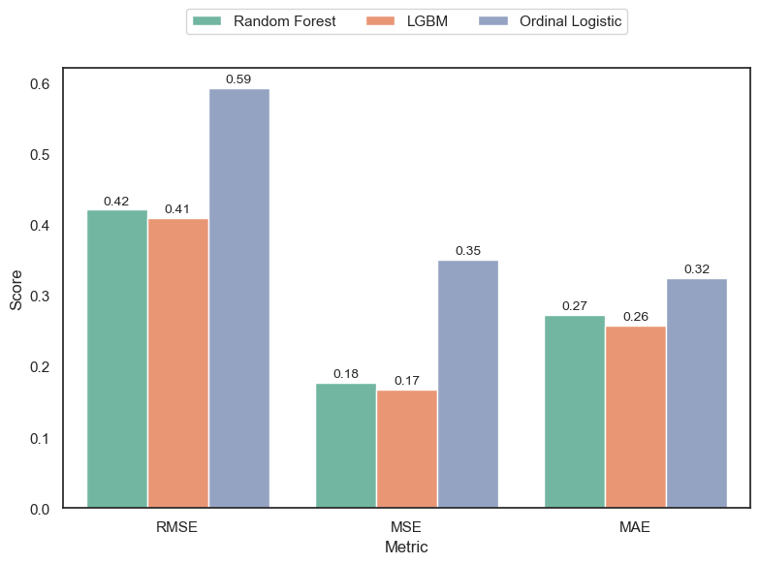
ML Implementation: M&E Quality vs. Outcome Ratings
Now, we implemented a machine learning pipeline to predict Outcome Ratings using structured project data. We evaluated predictive performance across 3 models: Random Forest, LightGBM, and Ordinal Logistic Regression.
We model Outcome Ratings (1 = worst, 6 = best) as the target variable, using project-level features—including M&E ratings, project characteristics, and country/institutional attributes—as predictors.
Model selection and tuning were performed using Optuna, optimizing for RMSE through cross-validation. Final models were evaluated on test set using RMSE, MSE, and MAE.
Results show that LGBM and Random Forest outperform Ordinal Logistic Regression across all metrics, suggesting that tree-based models capture complex, nonlinear patterns in the data more effectively.
Figure 7. Performance metrics for predicting Outcome Ratings (1 = worst, 6 = best) using the best Random Forest, Gradient Boosting, and Ordinal Logit models.

Slide 9
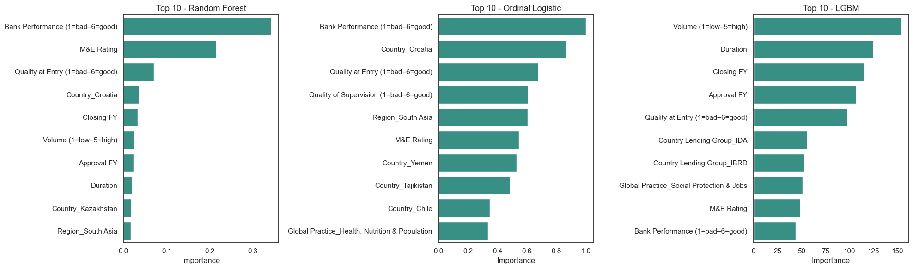
ML Implementation: M&E Quality vs. Outcome Ratings
Top predictors of project Outcome Ratings differ across models, but M&E Quality consistently ranks among the most important variables—highlighting its relevance even when accounting for other factors such as Bank Performance, Quality at Entry, project volume, and country characteristics.
Figure 8. Feature importance in the best Random Forest, Gradient Boosting, and Ordinal Logit models.

Slide 10
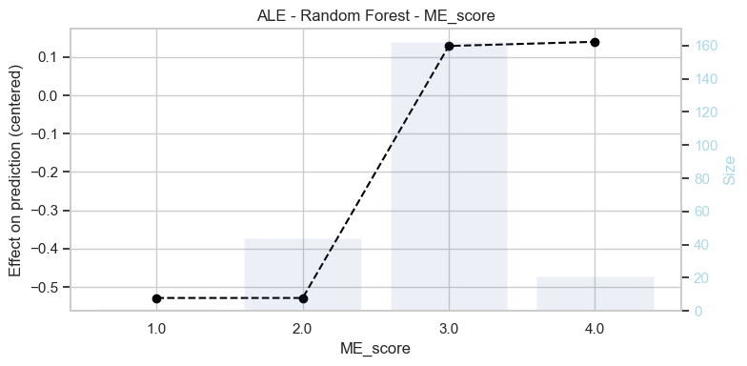
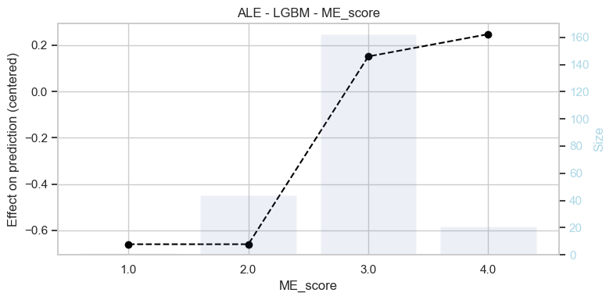
Interpretable AI: Accumulated Local Effects (ALE)
Figure 9. Accumulated Local Effects (ALE) estimated using the best Random Forest and Gradient Boosting models.
We use Accumulated Local Effects (ALE) to estimate the marginal impact of M&E Quality on predicted Outcome Ratings, isolating the effect of M&E while accounting for interactions and nonlinearity.
Results from both the Random Forest and LGBM models show a clear threshold effect:
Moving from low M&E scores (≤2) to scores of 3 or higher significantly increases the predicted outcome.
Beyond a score of 3, the effect plateaus, suggesting diminishing returns of very high M&E ratings.
This confirms that improvements in M&E Quality are particularly impactful when moving from low to moderate levels, reinforcing its role as a key driver of project success.

Slide 11
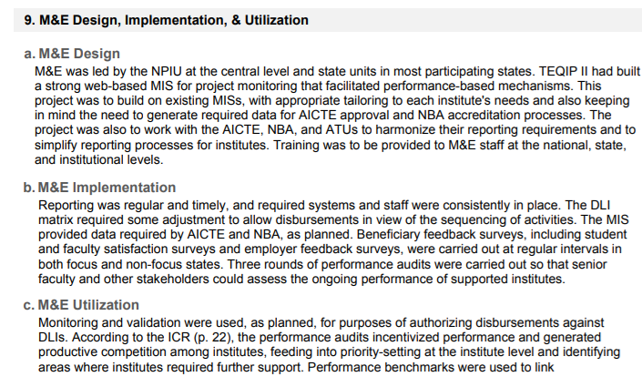
Sentiment Analysis
Now, I extracted full texts from IEG evaluation PDFs and used regular expressions to isolate key sections: M&E Design, Implementation, Utilization, and Lessons. Sentiment analysis was then applied.
Example. TEQIP III (India, 2016)

Slide 12
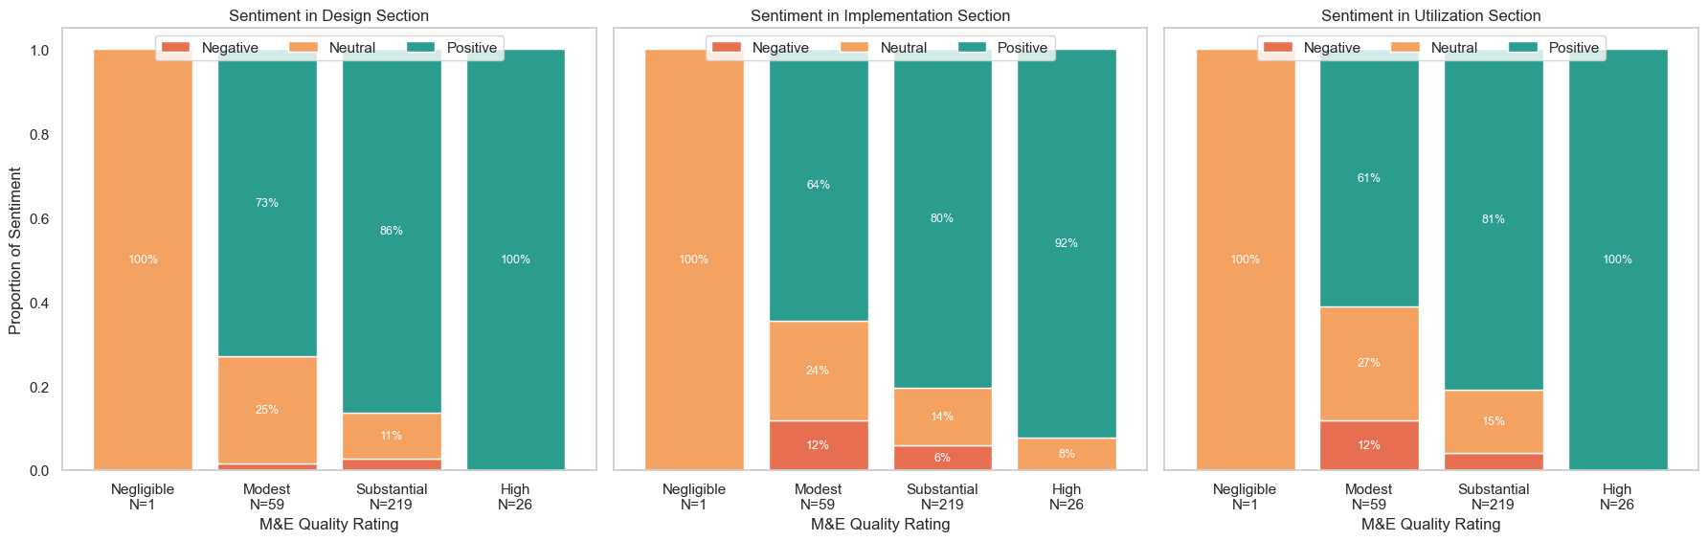
Sentiment Analysis
Now, I extracted full texts from IEG evaluation PDFs and used regular expressions to isolate key sections: M&E Design, Implementation, Utilization, and Outcome. Sentiment analysis was then applied.
Sections with more positive sentiment tend to be associated with higher M&E Quality ratings.
Figure 10. Sentiment analysis (Negative, Neutral, Positive) across the three sections of the M&E Evaluation (Design, Implementation, Utilization) by final M&E Quality rating.

Slide 13
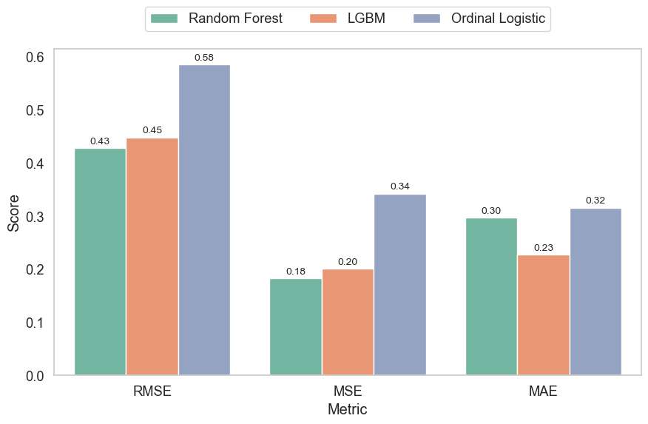
ML Implementation after Incorporating Sentiment Analysis
Now, I trained ML models to predict Outcome Ratings using sentiment scores derived from different sections of project evaluations (e.g., Lessons, M&E Design, Implementation, Utilization).
Figure 11. Performance metrics for the best Gradient Boosting, Random Forest, and Ordinal Logistic models after incorporating sentiment analysis.
Again, using Optuna, we tuned and compared three models—Random Forest, LightGBM, and Ordinal Logistic Regression—optimizing for predictive accuracy (RMSE) via cross-validation.
Final performance was evaluated on a test set using RMSE, MSE, and MAE.
Results show that sentiment-based features alone can meaningfully predict outcomes, with tree-based models again outperforming the ordinal baseline.

Slide 14
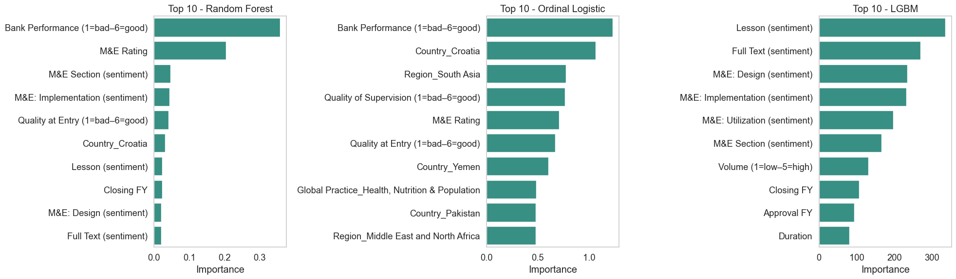
Feature Importance after Incorporating Sentiment Analysis
After including sentiment scores from project documents, models reveal that text-based variables—especially sentiment in Lessons and M&E sections—play a significant role in predicting Outcome Ratings.
These results highlight the added predictive value of qualitative insights from evaluation narratives, especially when using flexible models like LGBM.
Figure 12. Feature importance in the best Random Forest, Gradient Boosting, and Ordinal Logit models after incorporating sentiment analysis.

Slide 15
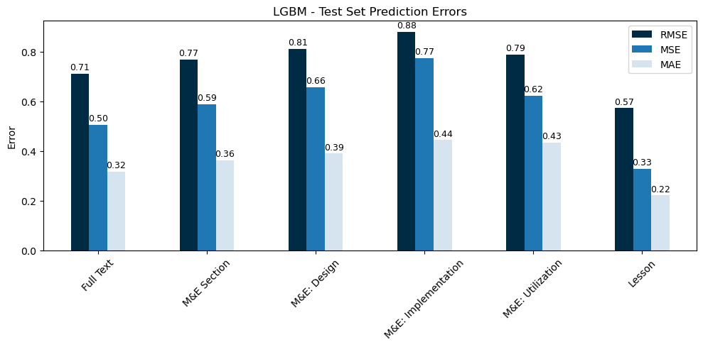
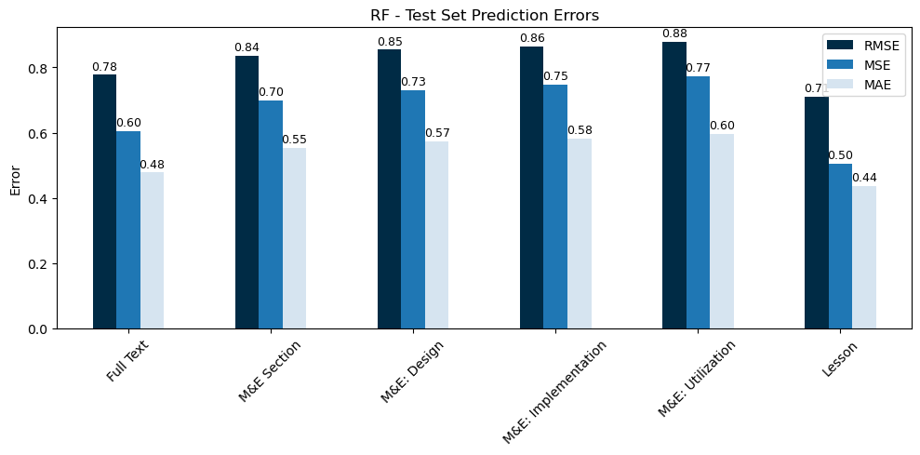
Predicting Outcomes from Textual Content
Figure 13. Performance metrics for the best Gradient Boosting and Random Forest models using text from specific sections.
We shift from using sentiment scores to leveraging the full textual content and specific sections extracted from evaluation PDFs.
Texts were preprocessed through lowercasing, stop word removal, and transformed using TF-IDF vectorization with 1- to 3-grams.
Using these features, we trained optimized Gradient Boosting and Random Forest models.
Results show that models using the Lesson section outperform all others, achieving the lowest RMSE, MSE, and MAE. This suggests that the narrative in the lesson section holds particularly strong predictive value for project outcomes.

Slide 16
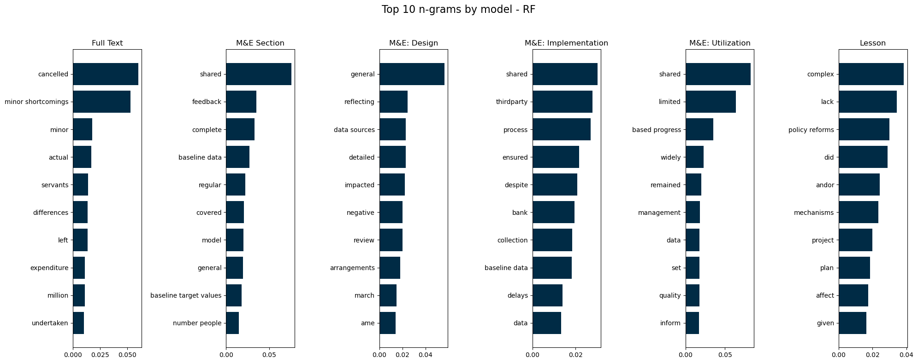
Top Predictive Terms by Text Section
The best Random Forest model reveals that specific terms—like “cancelled”, “complex”, “policy reforms”, or “shared”—are strong predictors of project outcomes. This highlights the value of section-level language patterns in evaluation texts for outcome prediction.
Figure 14. Feature importance in the best Random Forest model using text from specific sections.

